Slide 1
OCD PATIENT DATA ANALYSIS
By AVIRAJ MISHRA
July 15th ,2024

Slide 2
AGENDA
Introduction
Dashboard
Questions Solved
Insights
Suggestions and Recommendations

Slide 3
INTRODUCTION
The "OCD Patient Dataset: Demographics & Clinical Data" is a comprehensive collection of information pertaining to 1500 individuals diagnosed with Obsessive-Compulsive Disorder (OCD). This dataset encompasses a wide range of parameters, providing a detailed insight into the demographic and clinical profiles of these individuals.
Included in this dataset are key demographic details such as age, gender, ethnicity, marital status, and education level, offering a comprehensive overview of the sample population. Additionally, clinical information like the date of OCD diagnosis, duration of symptoms, and any previous psychiatric diagnoses are recorded, providing context to the patients' journeys.
Overall, this dataset serves as a valuable resource for researchers, clinicians, and mental health professionals seeking to gain a deeper understanding of OCD and its manifestations within a diverse patient population.

Slide 4
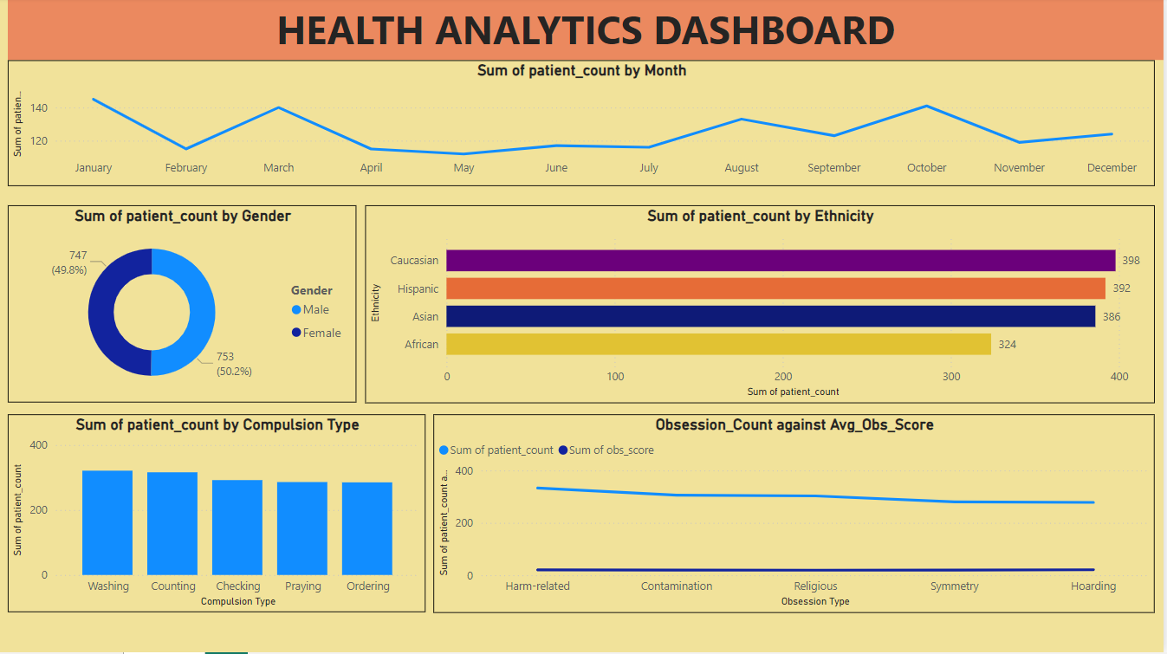

Slide 5

OCD PATIENT DATA ANALYSIS
COMPULSIVE PATTERNS : Analyzing patients compulsive behavior and insights on treating them.
GENDER ANALYSIS : Among male and female who suffers the most.
OBSESSIONS ANALYSIS : Analyzing the patients on the basis of their obsessions using Yale – Brown Obsessive-Compulsive Scale (Y-BOCS) scores.
This Photo by Unknown Author is licensed under CC BY-NC-ND

Slide 6
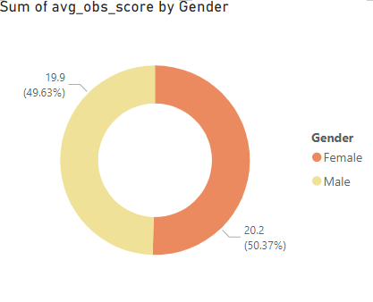
Ques 1. Count and Percent of Female vs Male that have OCD & Average Obsession Score by Gender.
INSIGHT : As we can see average obsession score among the two genders is not very different. Thus we can conclude OCD is among both male and female equally.

Slide 7
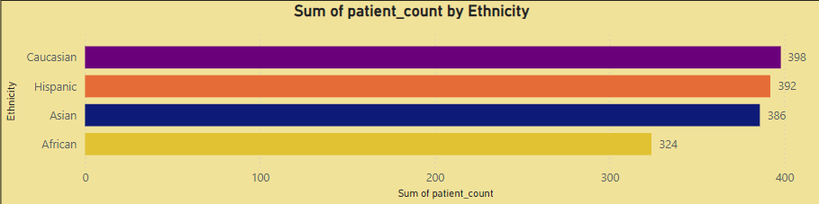
Ques 2. Count & Average Obsession Score by Ethnicities that have OCD.
Key Observations:
Caucasian Patients: This group has the highest patient count, indicating that Caucasians are the most represented in this dataset.
Hispanic and Asian Patients: These groups have a slightly lower but nearly equal representation, suggesting similar levels of OCD diagnosis or treatment seeking among these ethnicities.
African Patients: This group has the lowest count, which might indicate underrepresentation or potential barriers to access or diagnosis.

Slide 8
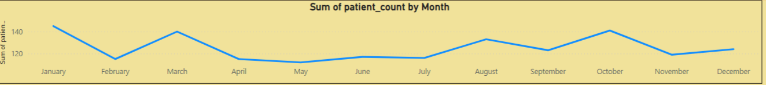
Ques 3. Number of people diagnosed with OCD Month of Month.
Key Insights:
High Patient Counts in January and August:
January: The peak in patient count may be due to the aftermath of holiday stress and the onset of New Year’s resolutions, prompting individuals to seek help.
August: The increase could be related to back-to-school stress and the end of summer vacations, leading to a spike in mental health consultations.
Lower Patient Counts in Spring and Early Summer (April to July):
This period shows a relatively stable and lower patient count, which might indicate fewer stressors or a general decrease in the tendency to seek treatment during these months.
Fluctuations in Fall:
The gradual decline from September to November, with a peak in October, suggests varying factors influencing mental health care-seeking behavior in the fall, such as changes in routine or seasonal affective disorder.

Slide 9
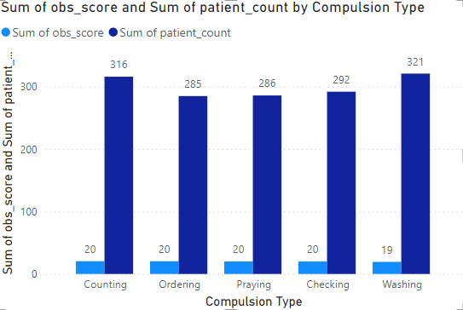
Ques 4. What is the most common compulsion type (Count) & its respective Average Obsession Score?
INSIGHT : A large no. of patients have the compulsion of washing and counting which can be treated with proper medication.

Slide 10
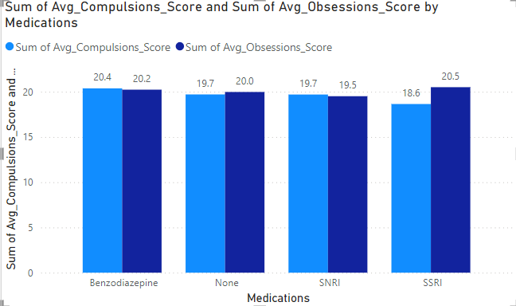
Question 5: What are the Common Medications and Their Effectiveness?
INSIGHT : Medicine which has the lowest average Y-BOCS score will be better option for treatment. So for SSRI is best for compulsions and SNRI is best for obsessions.

Slide 11
INSIGHTS
Patient Count by Ethnicity : The distribution suggests that Caucasians are the most represented, while Africans are underrepresented. This could indicate disparities in diagnosis, access to healthcare, or cultural attitudes towards seeking treatment.
Severity of OCD symptoms may vary with age, requiring age-specific treatment approaches.
The patient count fluctuates throughout the year, with peaks in January and August, and a general decline in spring and fall months, indicating seasonal influences on mental health care-seeking behavior.
Understanding the genetic component can guide early interventions and tailored treatment plans for those with a family history of OCD.

Slide 12
SUGGESTIONS AND RECOMMENDATIONS
Addressing Ethnic Disparities : Increase awareness and encourage help-seeking in underrepresented ethnic groups, particularly the African community.
Public Awareness Campaigns : Launch support programs in late summer to mitigate back-to-school stress and reduce the August peak.
Genetic Component Consideration:
Early Screening: Implement early screening for individuals with a family history of OCD.
Tailored Treatments: Develop personalized treatment plans for patients with genetic predispositions to OCD.
Continuous Data Monitoring:
Trend Analysis: Regularly analyse patient data to identify emerging trends and adjust strategies accordingly.
Feedback Mechanism: Establish a feedback loop with patients to continuously improve intervention strategies based on real-time data.

Slide 13


